Slide 1
MVC Pattern
意图：MVC将交互式应用系统构造成3个软构件及其之间
协调的体系结构。
M(model):包含应用系统的核心功能、数据；V(view):向用户
显示信息，提供界面；C(controller):处理用户的输入、输出。

Slide 2
MVC结构
Observer
update
调用update
*
Model
coreData
setOfObservers
attach(Observer)
detach(Observer)
notify
getData
service
View
myModel
myController
initialize(Model)
makeController
activate
display
update
getData
生成
Controller
myModel
myView
initialize(Model,View)
handleEvent
update
显示
调用服务程序

Slide 3
MVC行为协调
系统更新传播机制的行为协调：用户输入引起M更新的更新传播：
☆C使用事件处理用户输入，解释事件，激活M的服务程序；
☆M执行所要求的服务，执行结果改变M内部的数据；
☆M通知在系统更新传播机构中被登录的所有的V和C。所谓
通知，是调用执行V、C的更新程序；
☆各V要求M更新数据，并在画面上再显示；
☆系统更新传播机构中被登录的各个C，为了支持用户功能
实现/或者不实现(enable or disable)，需要从M取得数据；
☆C再获得控制权，返回事件处理程序。

Slide 4
行为协作图
Controller
Model
View
handleEvent
service
notify
update
display
getData
update
getData

Slide 5
MVC初始化行为的协调
☆生成M的例示。进行M内结构的初始化；
☆生成V对象；
☆V通知M的系统更新传播机构，为此调用M的attach函数；
☆V继续初始化处理，生成其C。接着进行M自身的访问处理，
继续执行C的初始化程序；
☆ 经过登录，C通知M的系统更新传播机构；
☆初始化处理结束后，开始进行应用程序的事件处理。

Slide 6
MVC初始化行为的协调图
main program
Model
View
Model
initialize
attach makeController
initialize
attach
startEventProcessing
View
Controller
Model,View
Controller

Slide 7
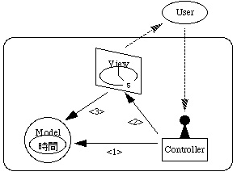
MVC

Slide 8
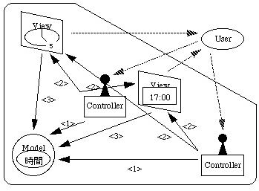
MVC

Slide 9
反射(Reflection)
反射的分类
反射体系结构模式
一个反射例子
一个反射系统
反射模式的应用

Slide 10
Reflection的两个功能
Introspection
    The ability to read the attributes of an object or class
Intercession
    The ability to modify the behaviour of an object or class

Slide 11
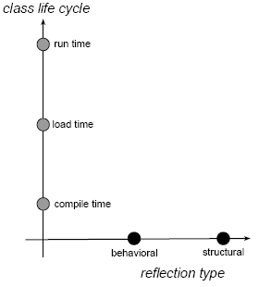
Different Types of Reflection
Egbert Althammer. Reflection Patterns in the Context of Object and Component Technology.

Slide 12
Different Types of Reflection
Structural Reflection
Structural reflection is concerned with the ability of the language to reflect both about the structure of the program as well as the program currently executed.

Slide 13
Different Types of Reflection
Behavioral Reflection
Behavioral reflection is the ability of the programming language to reflect about its own semantics and implementation as well as the data and implementation of the runtime system.

Slide 14
Different Types of Reflection
Compile-time Reflection
Load-time Reflection
Runtime Reflection

Slide 15
Reflection architectural pattern
This pattern separates an application in two levels: a base level and a meta level.
The base level defines the application’s logic.
The meta level consists of metaobjects that encapsulate and represent information about the base-level objects.

Slide 16
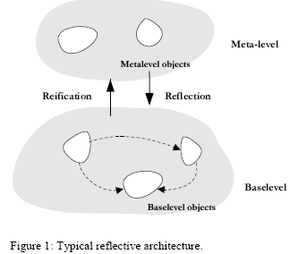
Reflection architectural pattern

Slide 17
An example in using a mirror
Junichi Suzuki. The Reflection pattern in the immune system
We use a mirror to shave.
The mirrored face represents the state of the real one.
We shave seeing it, because we cannot see the real face directly.

Slide 18
An example in using a mirror
In terms of the reflection pattern, a mirror is a metaobject and a person in front of the mirror is a baseobject.
A baseobject can determine its behavior by referring its status with the corresponding metaobject, because the information on the baseobject is reified into the metaobject.

Slide 19
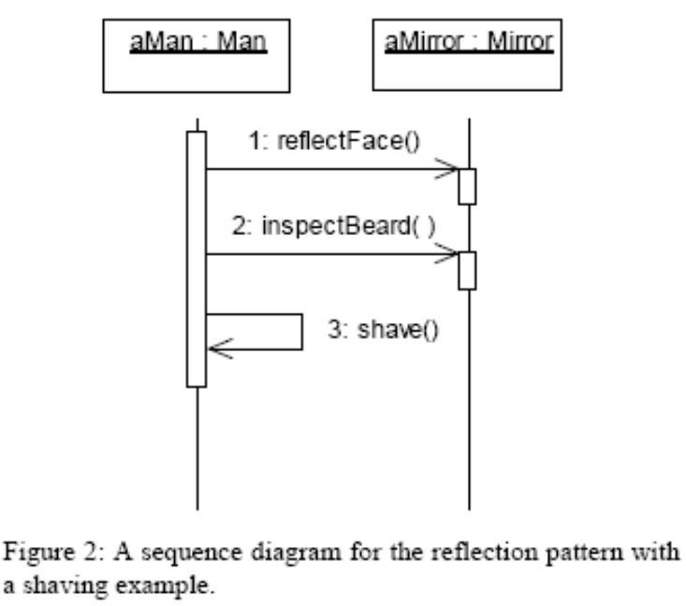
An example in using a mirror
The method reflectFace() reifies the aMan and creates aMirror. Standing in front of a mirror is considered as invoking this method.
The method inspectBeard() checks whether the beard remains on the face by referring on the mirror.
The method shave() shaves the beard in response to the result of inspectBeard().

Slide 20

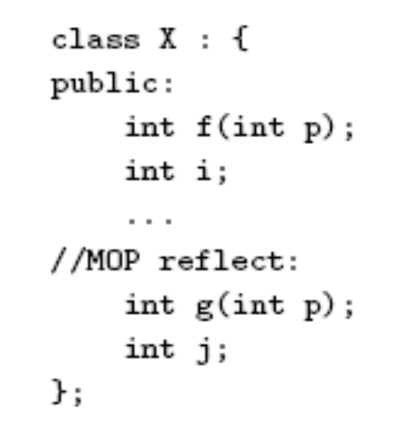
OpenC++
Shigeru Chiba. A Metaobject Protocol for C++.
基本级的定义
  reflect对象
  reflect方法，reflect变量
    受元对象控制的方法和变量
  普通方法和变量

Slide 21
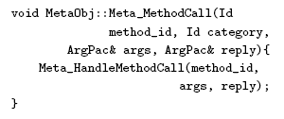
OpenC++
消息截取
Meta_HandleMethodCall方法执行实际被调用的reflect方法

Slide 22
OpenC++
reify和reflect
  reify:处理从基本级转到元级时，信息到一阶（first class）数据的转换过程。
  reflect:处理从元级转到基本级时，把一阶数据反映到系统内部的过程。

Slide 23
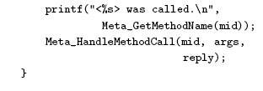
OpenC++
功能扩充

Slide 24
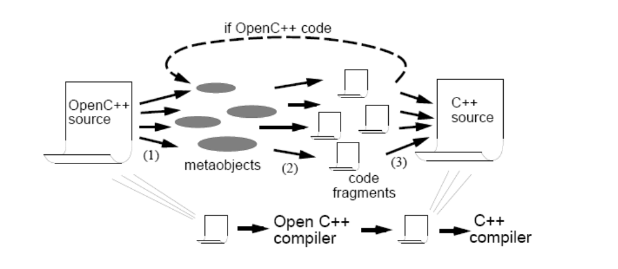
OpenC++

Slide 25
MOP
The relationship among the base-level objects and the meta-level objects is specified by metaobject protocol (MOP).
A set of interfaces with which a baseobject interacts with its metalevel is called Metaobject Protocols or MOPs.

Slide 26
MOP
a metaobject protocol establishes the following interactions
  attachment of base-level and meta-level objects, that can be static or dynamic, and in one-to-one or many metaobjects to one base-level object basis;
  Reification, which means materialization of information otherwise hidden from the program, such as incoming and outcoming messages, arguments, data and other structural information;

Slide 27
MOP
  Execution, which consists of meta-level computation that interferes in the base-level behavior transparently through the interception and reification mechanisms;
  Modification, which consists of meta-level computation that interferes in the base-level behavior transparently through the interception and reification mechanisms.

Slide 28
The Reflective State Pattern
Luciane Lamour Ferreira. The Reflective State Pattern
To separate the control aspects related to states and their transitions from the functional aspects of the State pattern.
These control aspects are implemented in the meta level by means of the metaobjects.

Slide 29
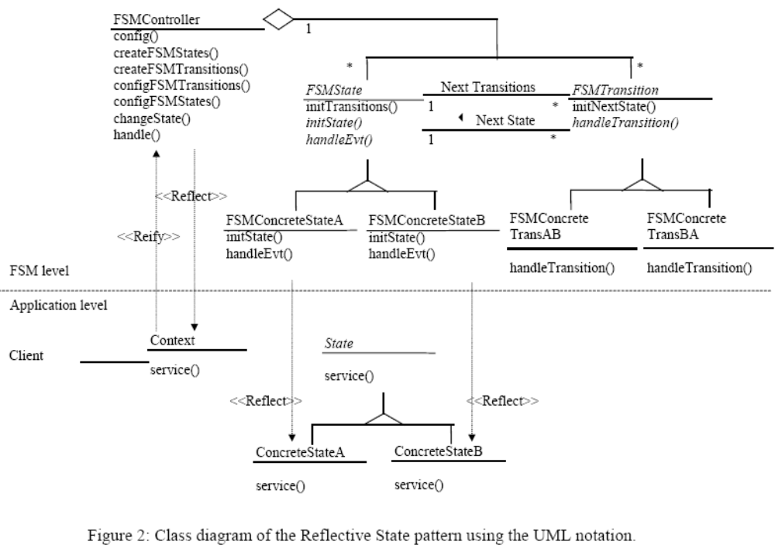

Slide 30
